Slide 1
A POLICY REVIEW OF THE TOURIST GUIDING SECTOR IN SOUTH AFRICA
Prof Karen Harris CR Botha Tiffaney da Gama Sian Pretorius
Department of Historical and Heritage Studies University of Pretoria (2017-2018)
Research Seminar 23 March 2018

Slide 2
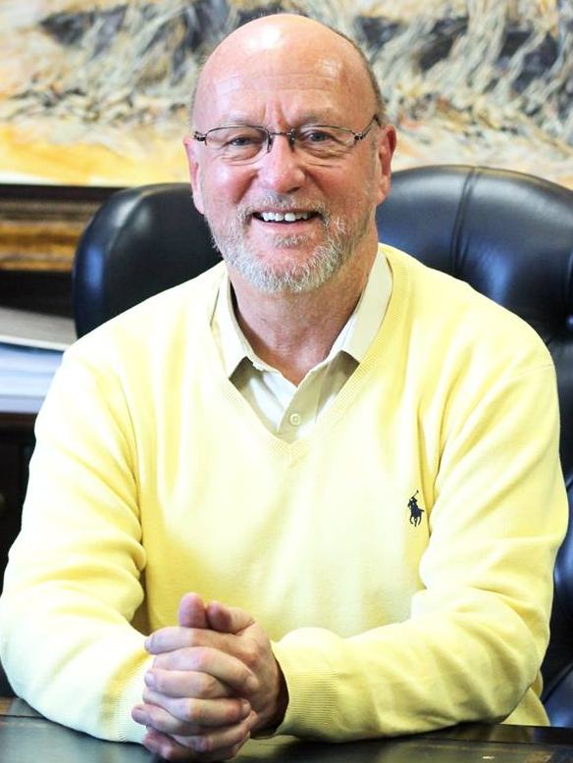
Minister of Tourism
Derek Hanekom:
“tourist guides are absolutely critical to the continuing success and growth of tourism in our country”. (2017)

Slide 3
Mid-point or epi-centre
Multivariate nature
Direct and indirect variables
Tourist guide
Dependent on multi-layered entities
Integral and indispensable

Slide 4
TG
Tourist guide at the epi-centre

Slide 5
TG
Various sectors that impact on the tourist guide

Slide 6
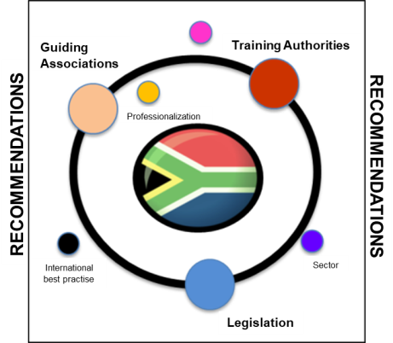
LEGISLATION
TRAINING AND ACCREDITATION
PROFESSIONALISATION & ASSOCIATIONS

Slide 7
Defining and contextualising
Legislative and regulatory dimension
Training and accreditation
Issues of associations and professionalisation

Slide 8
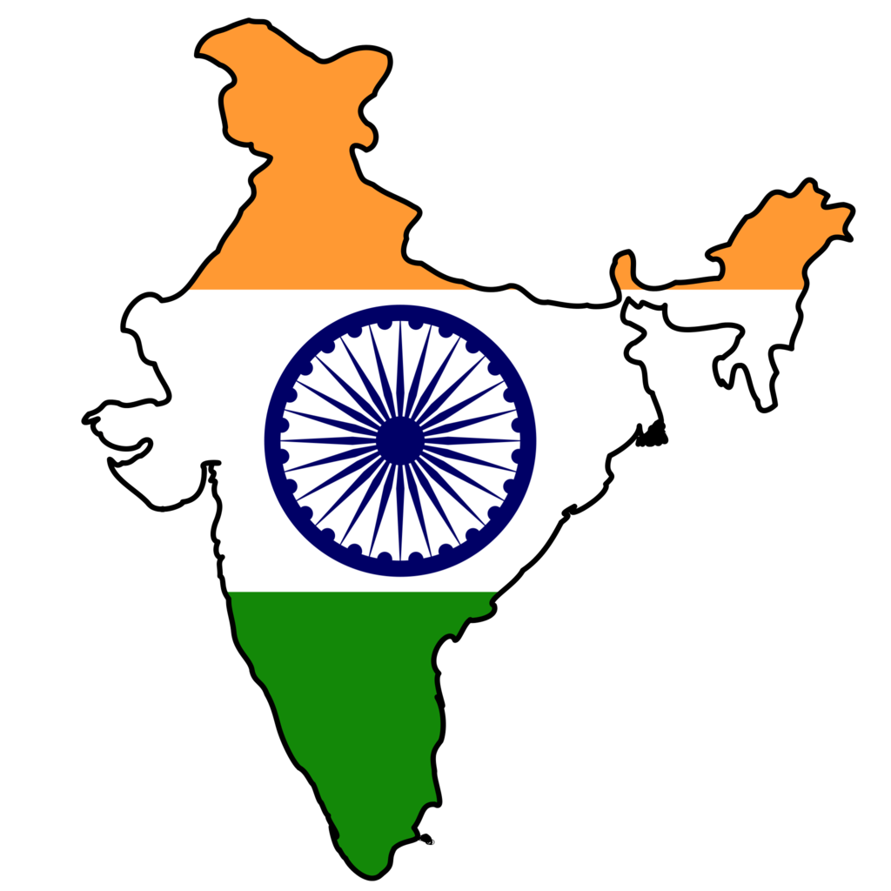
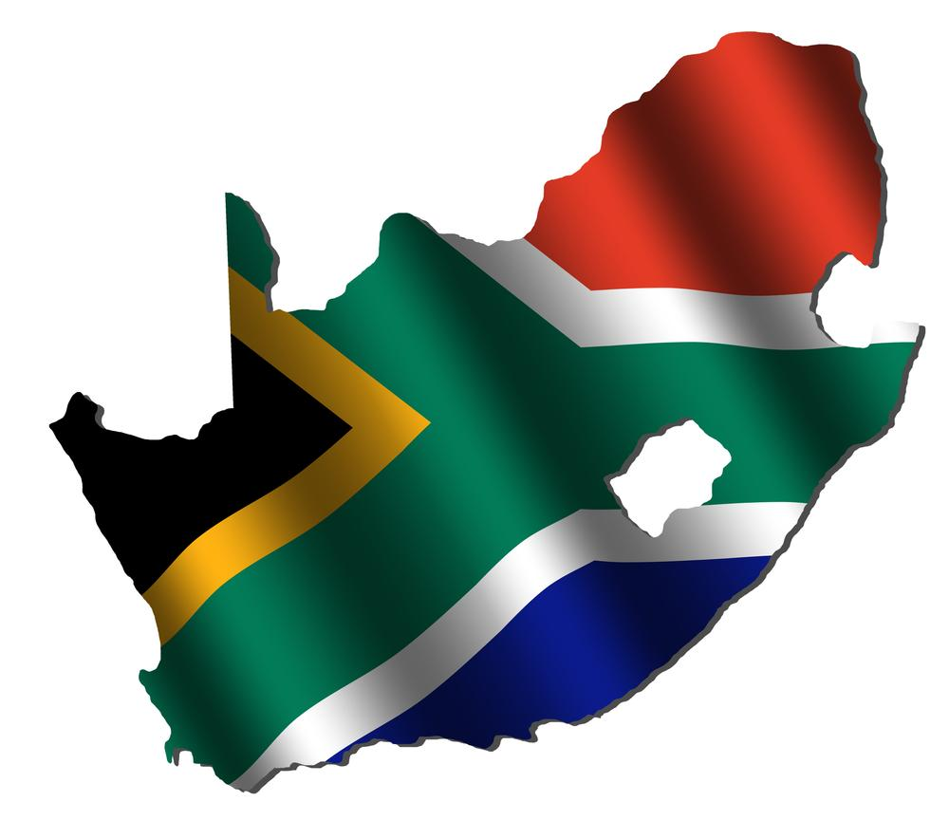
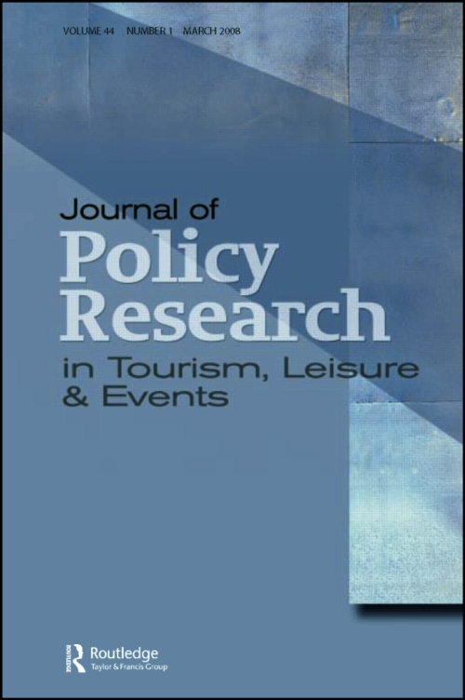
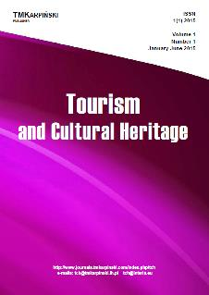
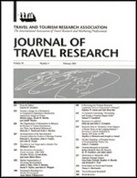
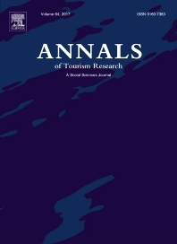
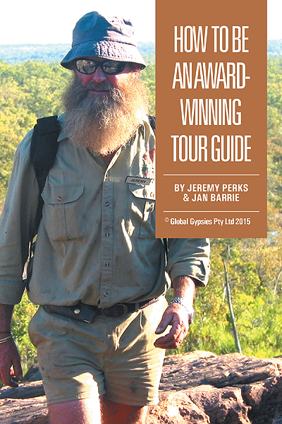
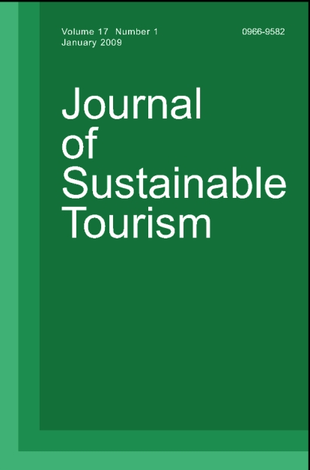
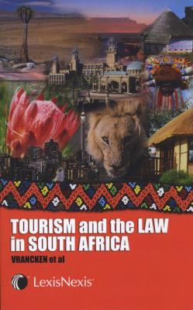
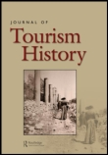
LITERATURE
Best practice in over twenty countries primarily from the global South

Slide 9
TOURIST GUIDE
Organiser
Actor
Interpreter/Translator
Salesperson
Buffer
Information-Giver
Teacher
Shaman
Catalyst
Ambassador
Mediator
Caretaker
Middleman
Intermediary
Culture Broker
Leader

Slide 10
ROLE OF TOURIST GUIDE EVOLVES:
Service-based
Experienced-based
Change from
Within and without
Numerous determinants
Dynamic situation
Need for constant reappraisal
Need for this
kind of research
on an on-going basis

Slide 11
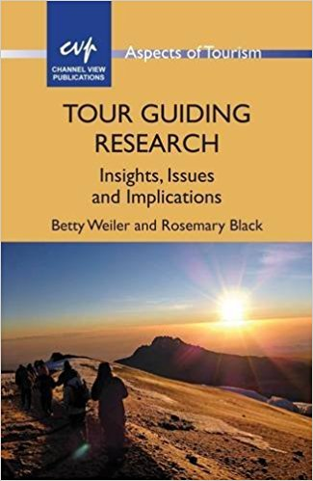
OUTCOMES AND MECHANISMS:
Weiler & Black:
3 achievable outcomes:
Raising awareness of importance of guiding
Helping achieve minimum guiding standards
Rewarding advanced performance of guiding
roles
5 mechanisms:
- Professional certification (& recertification)
Licensing (& enforcement)
Code of conduct (ethical & quality issues)
Awards of excellence (relevance, exclusive)
Professional Associations (networking)

Slide 12
SOUTH AFRICAN GOVT
Formalised tourist sector
Advanced regulations
Economic potential
Poverty alleviation
Transform society

Slide 13
LEGISLATION
1927 - South Africa Harbours and Railw ays
1938 - Tourist Development Corporation Act
1947 - South African Tourist Corporation Act
1963 - SA Department of Tourism
1978 - Tour Guides Act no 29
1983 - South African Tourism Board Act
1986 - DEAT established
1993 - Tourism Act no 72
1996 - Tourism Amendment Act no 105
2000 - Tourism Amendment Act no 8
2000 - Tourism Second Amendment 70

Slide 14
ACT NO. 3 TOURISM ACT, 2014
To provide for the development and promotion of sustainable tourism for the benefit of the Republic, its residents and its visitors; to provide for the continued existence of the South African Tourism Board; to provide for the establishment of the Tourism Grading Council; to regulate the tourist guide profession; to repeal certain laws; and to provide for matters connected therewith.
PREAMBLE SINCE tourism in South Africa has grown considerably since the country’s first democratic election;
AND SINCE inadequate, uncoordinated, inconsistent and fragmented tourism planning and information provision is the most pervasive challenge facing the development and growth of tourism in the Republic;
AND SINCE transformation is vital to ensure the sustainable growth and development of the tourism sector;
AND SINCE these challenges are best addressed through a concerted effort by all spheres of government and the private sector to work together to create an environment that is conducive to the sustainable growth, development and transformation of tourism,
AND SINCE inadequate, uncoordinated, inconsistent
and fragmented tourism planning and information
Provision is the most pervasive challenge facing the
development and growth of tourism in the Republic;

Slide 15
LEGISLATION
1996 - White paper development of To urism
1995 - SA Qualification Authority Act
National Qualifications
(education & training systems)
1998 - Skills Development Act
2001: THETA
2012: CATHSSETA
(quality assurance)
2009 - DEAT→NDT
2014 - Tourism Act no 3
Regulations (?)

Slide 16
SKILLS DEVELOPMENT ACT
SA QUALIFICATIONS AUTHORITY ACT
TG

Slide 17
Comparison between the Tour Guides Act, Act 29 of 1978, the Tourism Act, Act 72 of 1993,
the Tourism Second Amendment Act, Act 70 of 2000 and the Tourism Act, Act 3 of 2014
Tour Guides Act, Act 29 of 1978 | Tourism Act, Act 72 of 1993 | Tourism Second Amendment Act, Act 70 of 2000 | Tourism Act, Act 3 of 2014
To provide for the registration of tour guides and for matters connected therewith. | Intention To make provision for the promotion of tourism to and in the Republic; the further regulation and rationalization of the tourism industry; measures aimed at the maintenance and enhancement of the standards of facilities and services hired out or made available to tourists; and the co-ordination and rationalization, as far as practicable, of the activities of persons who are active in the tourism industry; with a view to the said matters to establish a board with legal personality which shall be competent and obliged to exercise, perform and carry out certain powers, functions and duties; to authorize the Minister to establish a grading and classification scheme in respect of accommodation establishments, the membership of which shall be voluntary; to authorize the Minister to establish schemes for prescribed sectors of the tourism industry, the membership of which shall be voluntary; to make provision for the registration of tourist guides; to prohibit any person to act for gain as a tourist guide unless he has been registered as a tourist guide in terms of the Act; to authorize the Minister to make regulations; and to provide for matters connected therewith. | Intention To amend the Tourism Act 1993, so as to insert certain definitions; to further provide for the training and registration of tourist guides; to make provision for a code of conduct and ethics for tourist guides; to regulate the procedure for lodging complaints; to make provision for the endorsement of certain registers in appropriate cases; to provide for disciplinary measures, appeals and reviews; to criminalise certain conduct; to provide for transitional matters; and to provide for matters connected therewith. | Intention To provide for the development and promotion of sustainable tourism for the benefit of the Republic, its residents and its visitors; to provide for the continued existence of the South African Tourism Board; to provide for the establishment of the Tourism Grading Council; to regulate the tourist guide profession; to repeal certain laws; and to provide for matters connected therewith. PREAMBLE SINCE tourism in South Africa has grown considerably since the country’s first democratic election; AND SINCE inadequate, uncoordinated, inconsistent and fragmented tourism planning and information provision is the most pervasive challenge facing the development and growth of tourism in the Republic; AND SINCE transformation is vital to ensure the sustainable growth and development of the tourism sector; AND SINCE these challenges are best addressed through a concerted effort by all spheres of government and the private sector to work together to create an environment that is conducive to the sustainable growth, development and transformation of tourism,

Slide 18
Extraneous legislation
Non-alignment
Devolution and debilitation of NDT’s powers

Slide 19
NGO’s
SATSA
SATOUR/SAT
Brand SA
SAQA
CATHSSETA
Police
Levels/ Grading
Conditions/ Salary
Trade & Industry
Accreditation
Economy
Awards
Categories
First Aid
Higher Education & Training
Tourist Guide
Life Long Years
Code of Conduct
Basic Education
Training
Legislation
Regulations
Registration
Disciplinary
Non-compliance
Employment
Environmental Affairs
International Arena
Provincial Department(s)
International Relations
Home Affairs
Arts & Culture
Tourism
Foreign Affairs
Transport

Slide 20
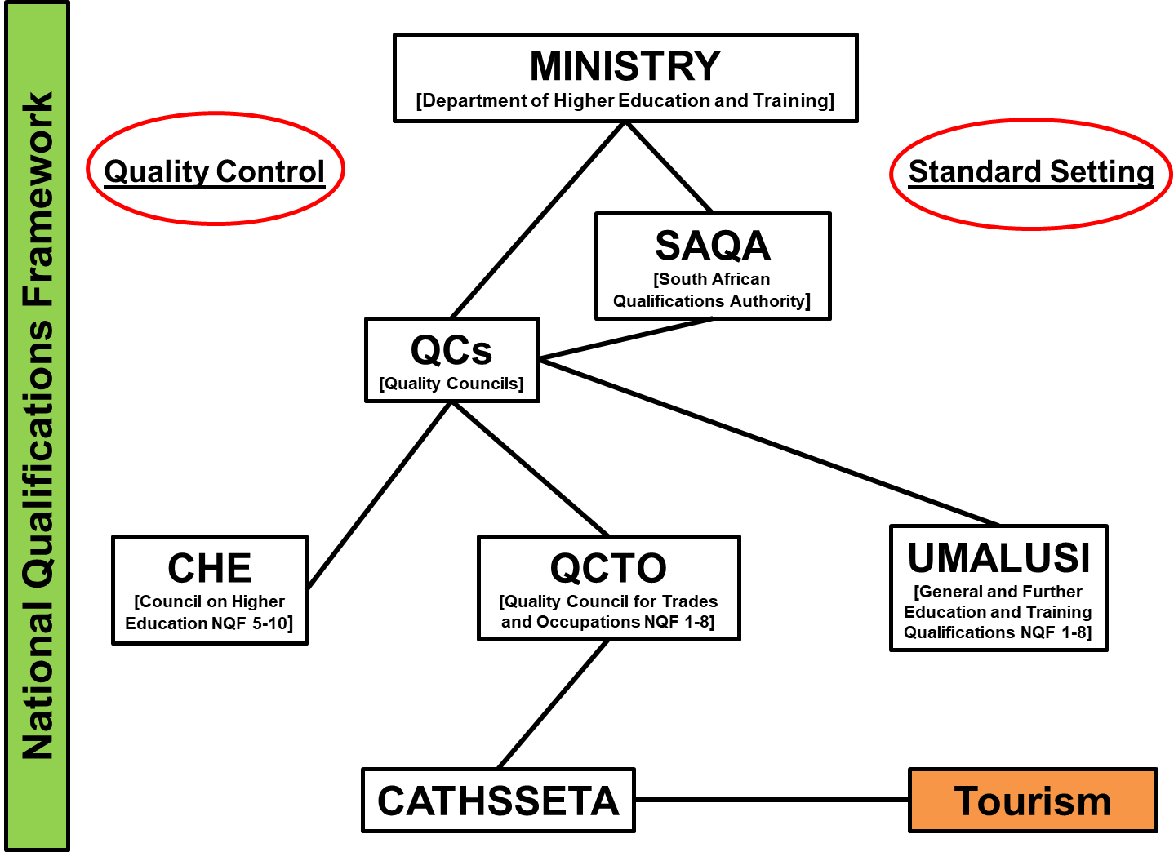

Slide 21
Example of unit standards – tourist guiding (NQF 4)
MODULE: | ID: | UNIT STANDARD TITLE: | PRE-NQF LEVEL | NQF LEVEL | CREDITS
Core | 335796 | Apply interpretation skills to a guided experience | Level 4 | NQF Level 04 | 5
Funda-mental | 119472 | Accommodate audience and context needs in oral/signed communication | Level 3 | NQF Level 03 | 5
Elective | 335802 | Conduct a guided cultural experience | Level 4 | NQF Level 04 | 12

Slide 22
Comparing tourist guiding registration processes in the global South:
:
SOUTH AFRICA
INDIA
Independent entity
Development
Management
Training
Regulation
MINIMUM REQUIREMENTS:
MINIMUM REQUIREMENTS:
ü
At least 18
years old
ü
Valid Indian citizen
ü
Graduate at tertiary level (preferable
Masters in any subject related to the field
of tourist guiding)
ü
At least 20 years old (at time of
registration)
ü
Fluent in English
ü
Fluent in one foreign language
ü
Fluent in one accepted regional
indigenous Indian dialect
ü
Sound nature and security to complete 16
week training programme
ü
Comprehension and drive to complete
programme
REGISTRATION PROCESS:
Un-complicating
& streamlining
processes
•
Complete and sign appl
ication form for
•
Completed and signed application form
RLGTPP (indicate site, state or regional
level and in what region)
•
Signed original of the code of conduct and
•
Complete 16 week subsidised and
ethics
monitored training programme (10 weeks
field work and six weeks theoretical)
•
Certified c
opy of proof of assessment from
•
Once completed register as si
te, state or
CATHSSETA
regional guide.
•
Certified copy of CATHSSETA certificate
•
Issued with tourist guiding license, badge
and card.
•
•
Attend compulsory refresher co
urses on a
Compliance with unit standards
bi
Ministry at the
HELM
of the industry
-
annual basis.
•
Certified copy of South African ID
•
Certified proof of language proficiency
•
Certified copies of all tourist guiding and
related qualifications
•
Certified copy of First Aid certificate
•
Four ID
-
size colour photos
•
Registration
fee (R240.00)
•
Tourist guide certificate (guiding card and
badge)

Slide 23
Professionalisation
Instated with recognition
Greater acknowledgement
Regional alignment and collaboration
Socio-economic upliftment
Overarching organisation – NTGA(1993)
National Registrar Morongoe Ramphele:
“I am of the view that being professional goes beyond simply
adhering to the legislation or belonging to an association, it
also describes the inherent qualities that the guide possesses
that relates to passion, dedication and commitment to the
guiding profession. It is also a personal responsibility
and interest in ensuring that one is in possession of the skills
and knowledge necessary to meet the challenges and
expectations of our dynamic tourism sector” (Feb 2018)

Slide 24
Proposed centrality of NDT
Career
Legislation
Training
NTGASA
Professionalisation
Associations
Accreditation
Compliance

Slide 25
Chowdhary and Prakash:
“tour guiding and interpretation is a basic
activity in [the] tourism value chain”,
“tourist guide’s performance depends on his
competences which in turn depends on the
training and learning he/she has been through”.
Chowdhary and Prakash claimed the RLGTP
unknowingly promoted:
indigenous knowledge
intangible heritage
a sense of community among locals, who are
actively involved in the programme or serve
in a contributing role to the programme.

Slide 26
RECOMMENDATIONS:
Remedied by elements that already exist
Align legislation and regulations
Cognisance of Acts of 1978, 1993 and 2000
NDT centre-stage and at the helm
Take a stand on impact of other departments
Collaborative national organisation
Sanction for UP to develop the IST
Parameters
Skilling and awareness
Ethics and authenticity

Slide 27
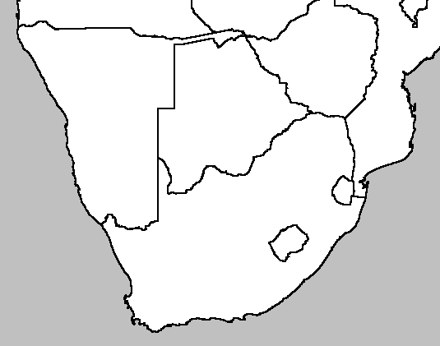
Tourist Guide Classification
Cross-border TG
National TG
Provincial TG
Local / Site TG
Specialist TG
?

Slide 28
INDIGENOUS STORY TELLER: IST

Slide 29
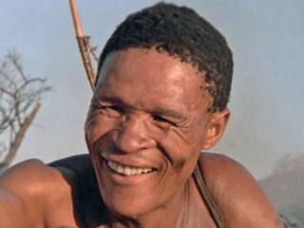
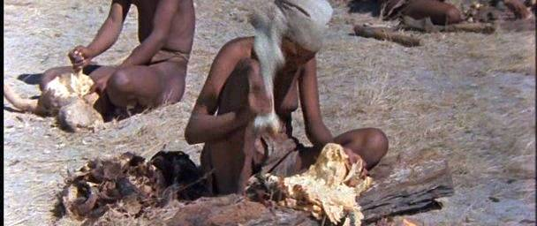
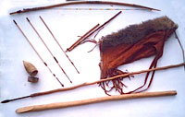
I S T

Slide 30
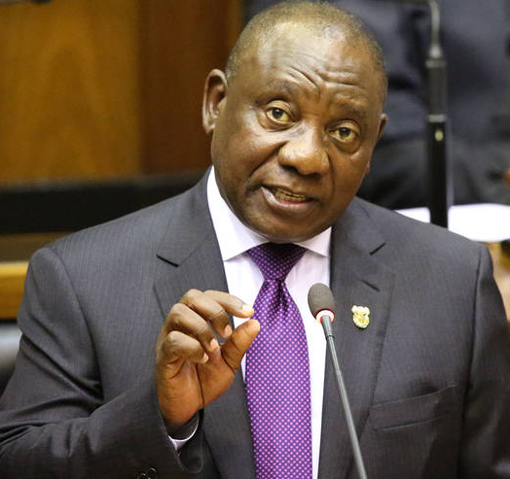
South African President
Cyril Ramaphosa:
“tourism provides our country with incredible opportunities to, quite literally, SHINE".
State of the Nation Address
(February 2018)

Slide 31
Thank you!
Professor Karen Harris
Mr CR Botha
Ms Sian Pretorius
Ms Tiffaney da Gama

